Slide 1
HASHING

Slide 2
Time complexity of Linear Search is O(n) and of Binary Search is O(log₂n).
Objective is to achieve O(1) time complexity so that searching doesn’t depend on the size of the input i.e. the number of elements in the array.

Slide 3
Hashing is an approach in which time required to search an element doesn't depend on the total number of elements. Using hashing data structure, a given element is searched with constant time complexity. Hashing is an effective way to reduce the number of comparisons to search an element in a data structure.
Hashing is the process of indexing and retrieving element (data) in a data structure to provide a faster way of finding the element using a hash key.
Here, the hash key is a value which provides the index value where the actual data is likely to be stored in the data structure.
In this data structure, we use a concept called Hash table to store data. All the data values are inserted into the hash table based on the hash key value. The hash key value is used to map the data with an index in the hash table. And the hash key is generated for every data using a hash function. That means every entry in the hash table is based on the hash key value generated using the hash function.

Slide 4
Hash table is just an array which maps a key (data) into the data structure with the help of hash function such that insertion, deletion and search operations are performed with constant time complexity (i.e. O(1)).
Hash tables are used to perform insertion, deletion and search operations very quickly in a data structure. Using hash table concept, insertion, deletion, and search operations are accomplished in constant time complexity. Generally, every hash table makes use of a function called hash function to map the data into the hash table.
A hash function is defined as follows...
Hash function is a function which takes a piece of data (i.e. key) as input and produces an integer (i.e. hash value) as output which maps the data to a particular index in the hash table.

Slide 5
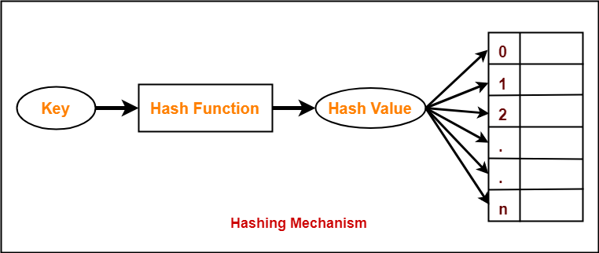

Slide 6
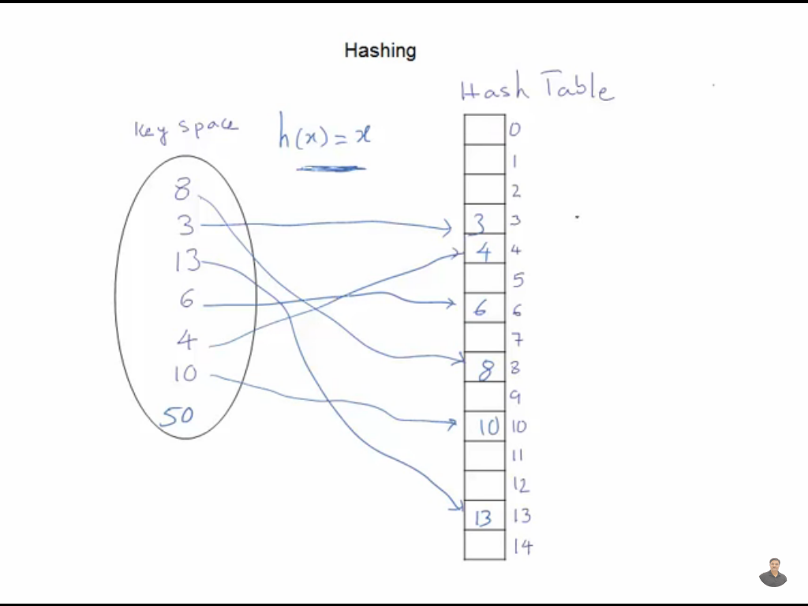

Slide 7
Types of Hash Functions
Division Hash Function
Mid Square Hash Function
Folding Hash Function etc.

Slide 8
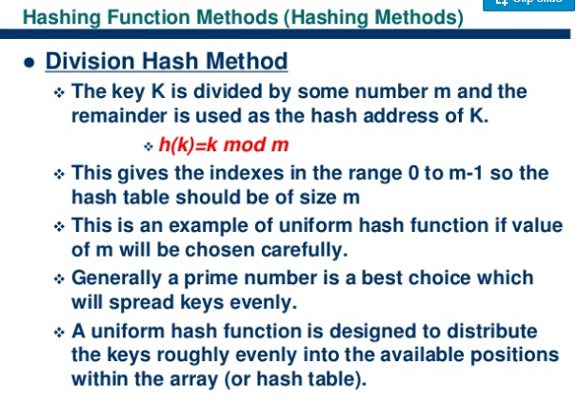

Slide 9
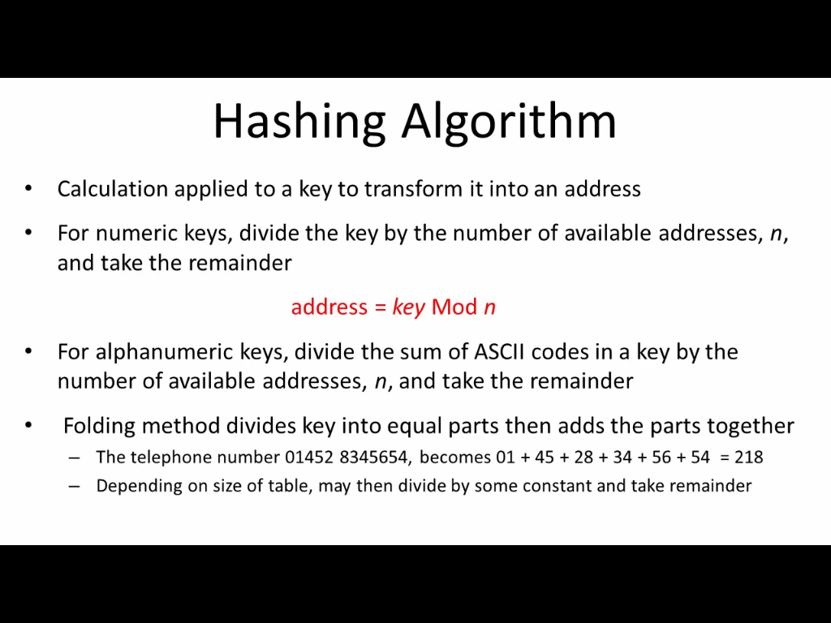

Slide 10
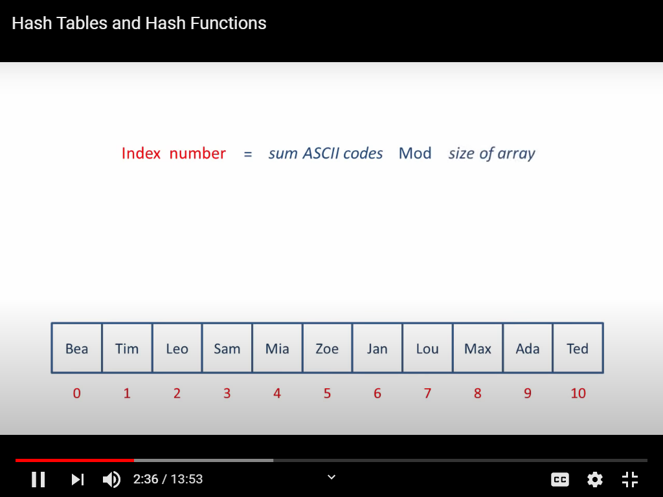

Slide 11
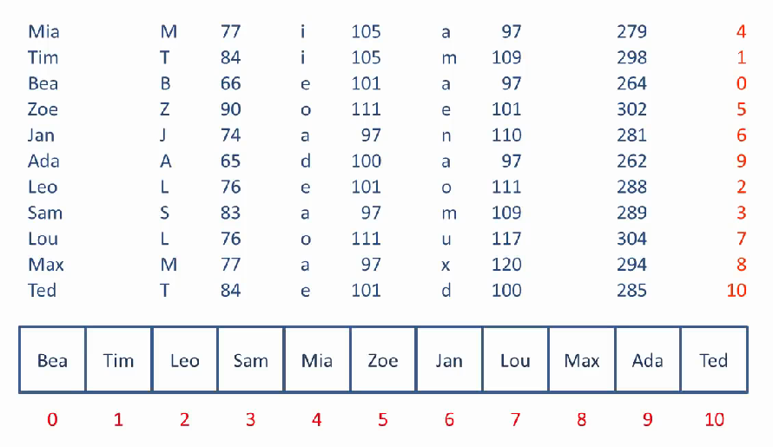
Sum of ASCII codes
Index=Sum%sizeofArray(11 here)

Slide 12
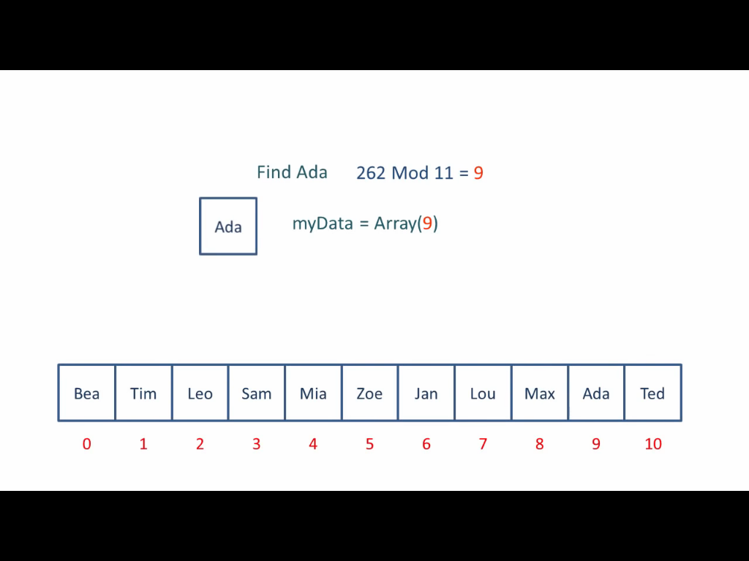

Slide 13
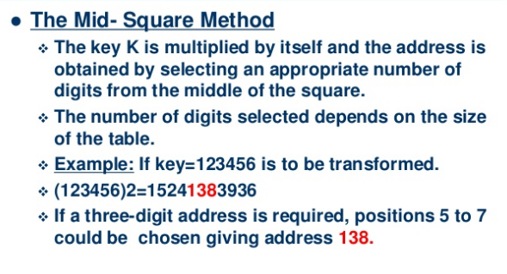

Slide 14
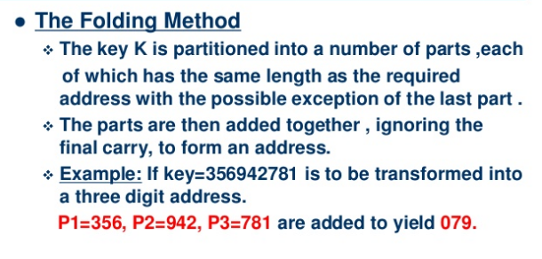
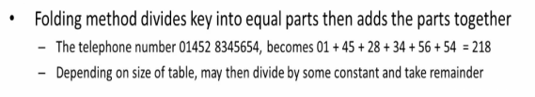
P1+P2+P3=2079, The carry 2 is ignored to form an address of three digit number

Slide 15
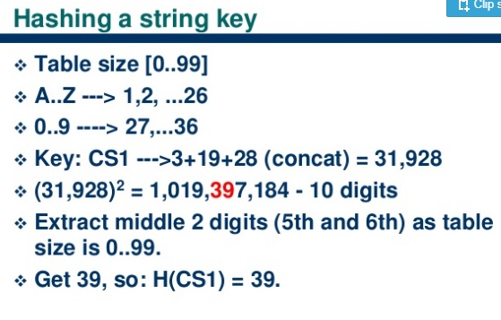

Slide 16
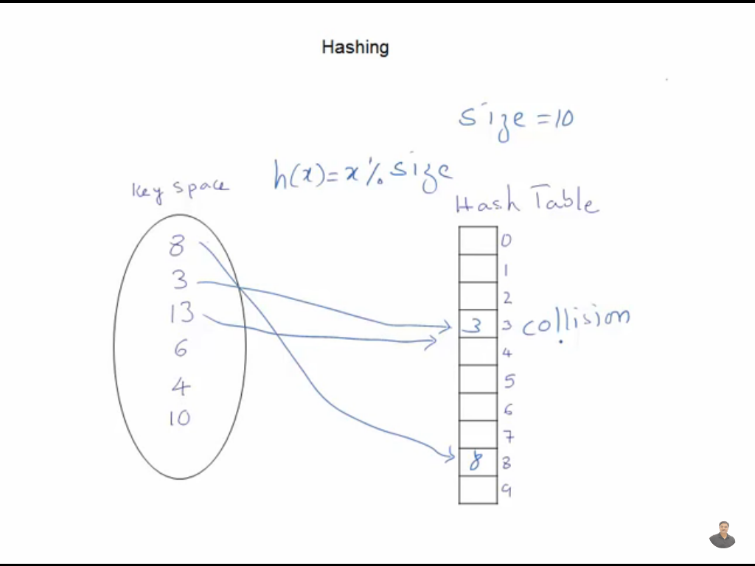

Slide 17
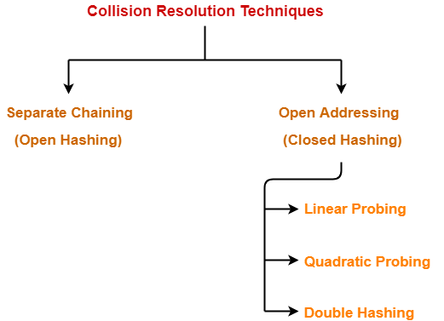

Slide 18
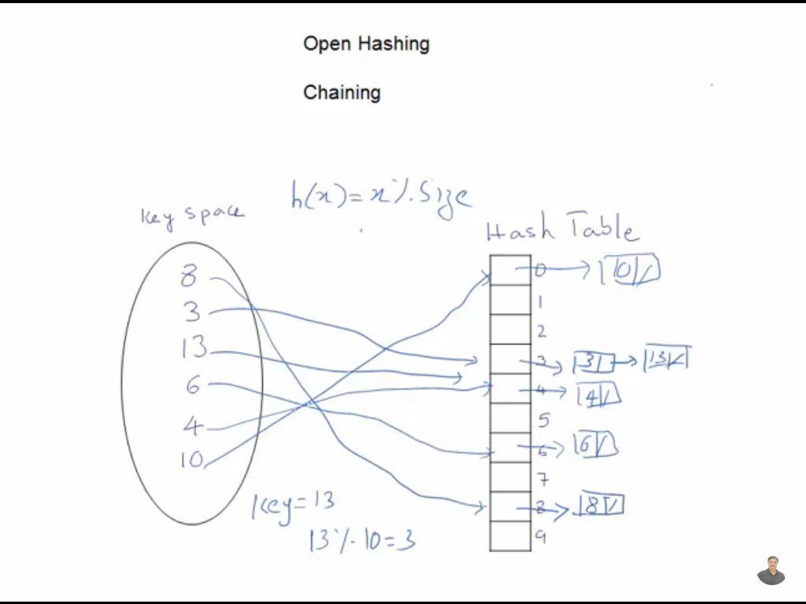

Slide 19
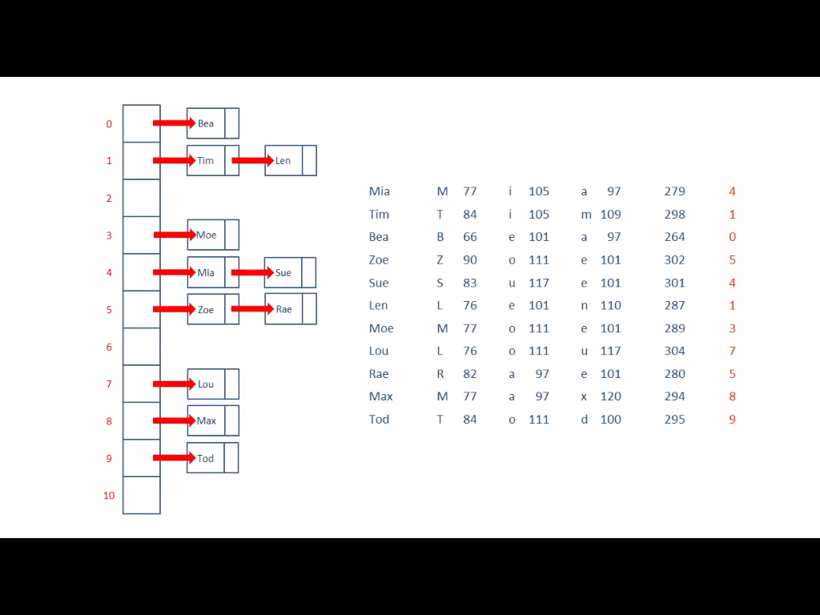

Slide 20
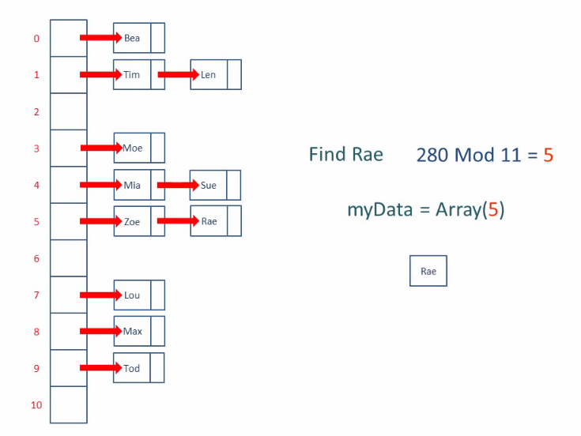

Slide 21
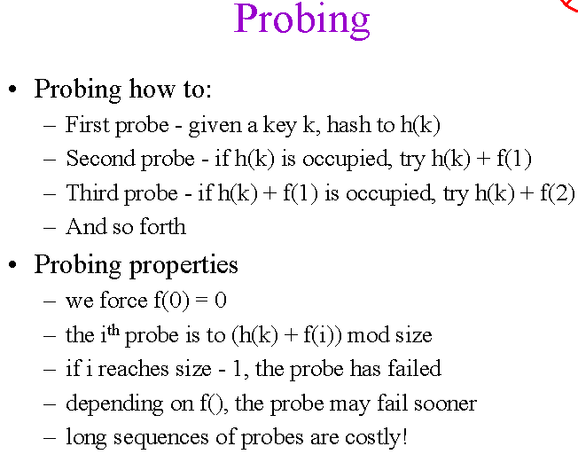

Slide 22
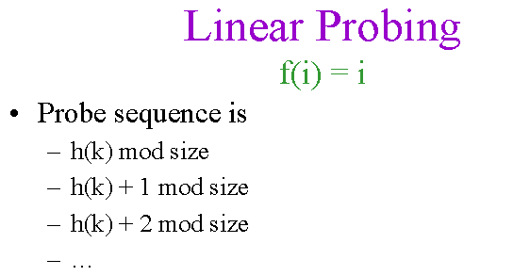

Slide 23
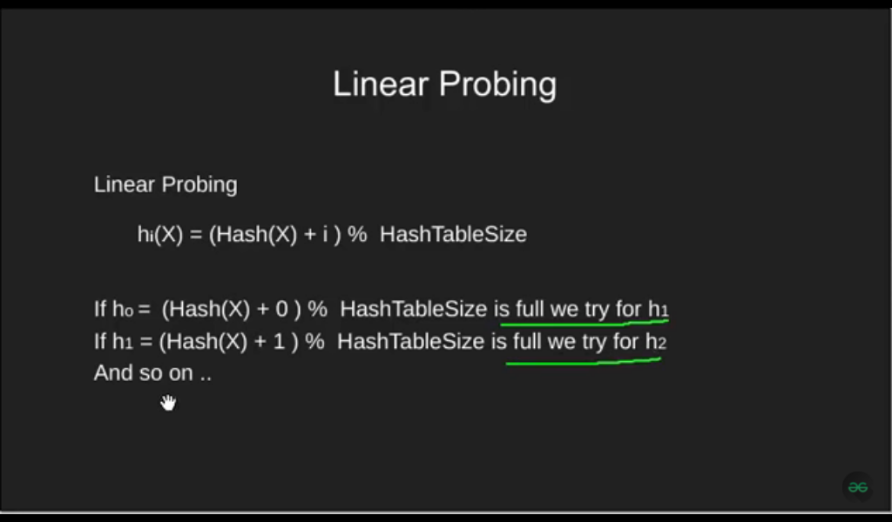

Slide 24
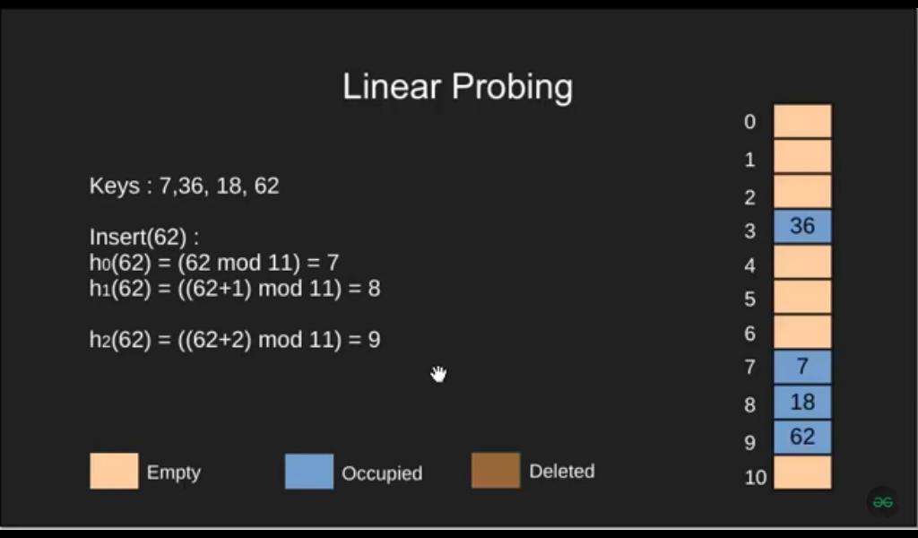

Slide 25
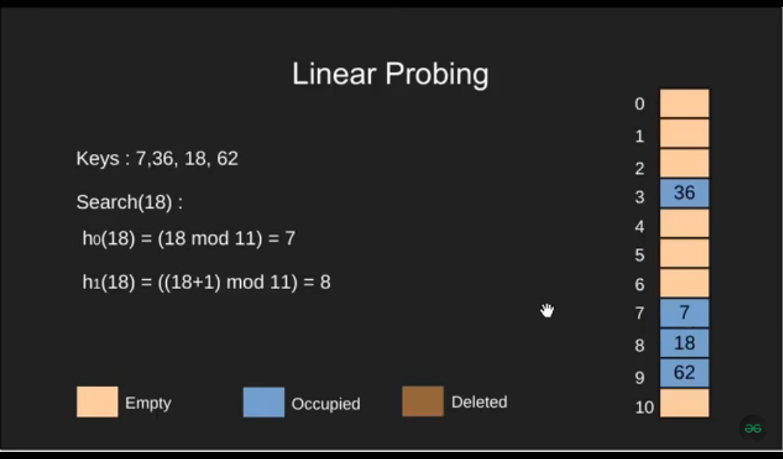

Slide 26
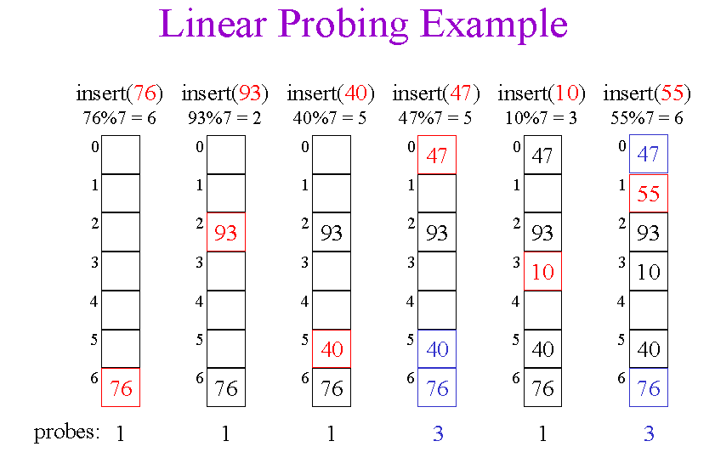

Slide 27
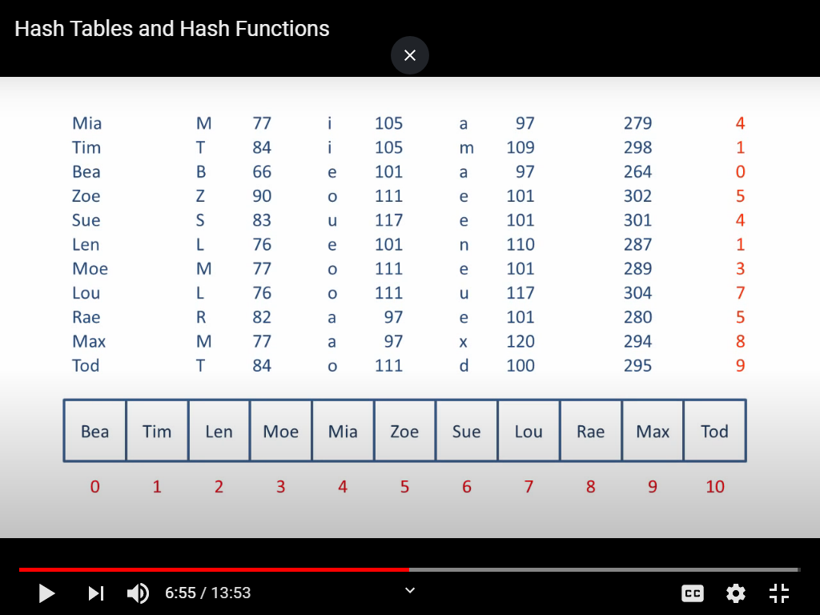

Slide 28
KCA-205, MCA -2021-22 [Q4(b), 10 marks]
Q. What do you understand by Hashing? Consider inserting the following keys
{ 76, 26, 37, 59, 21, 65, 88 } into a hashtable of size m=11 using Linear Probing. Consider the primary hash function as h(k)=k mod m

Slide 29
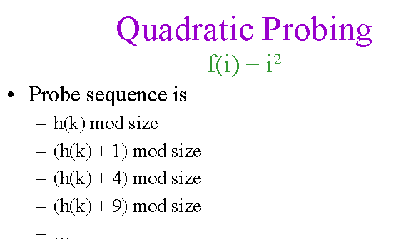

Slide 30
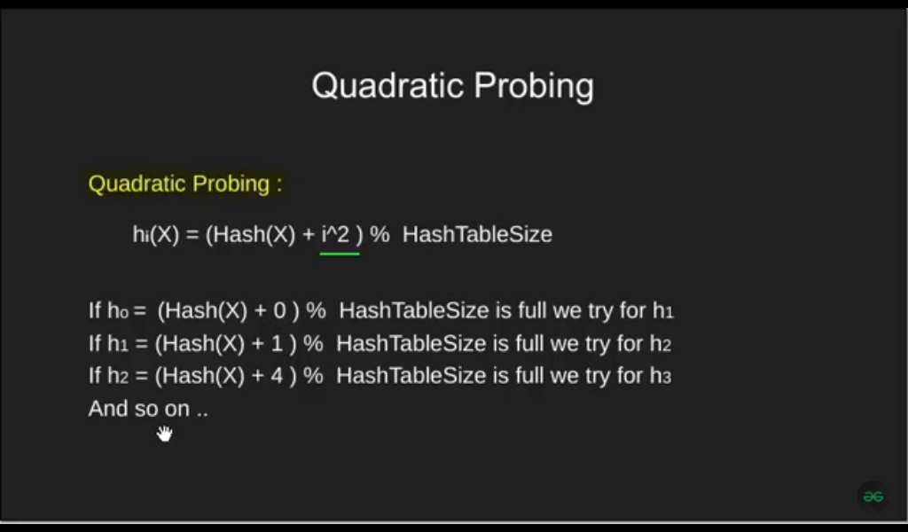

Slide 31
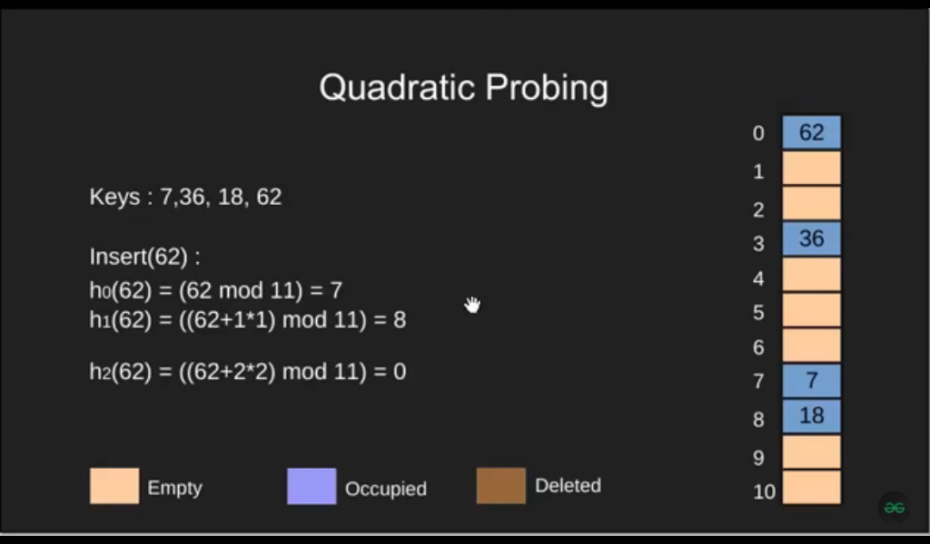

Slide 32
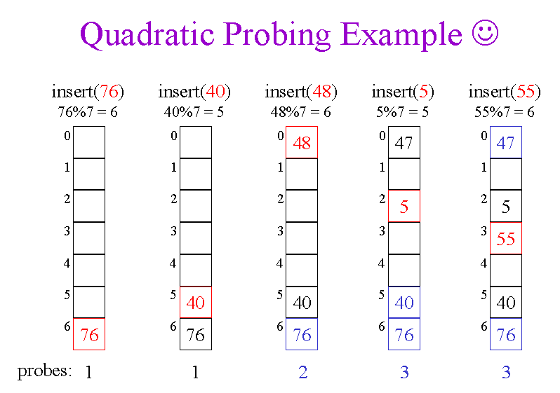

Slide 33
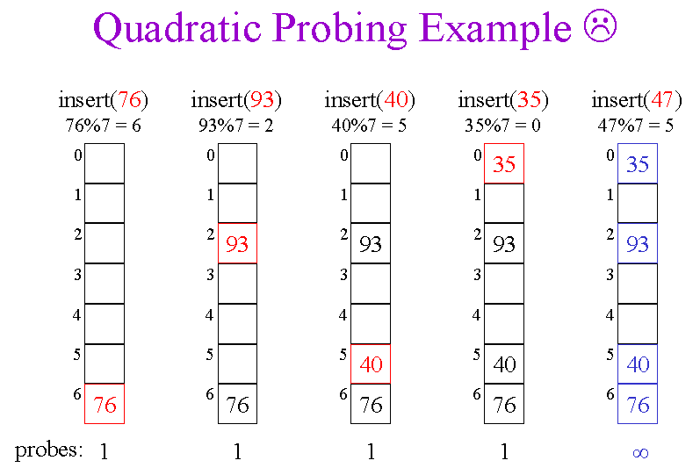

Slide 34
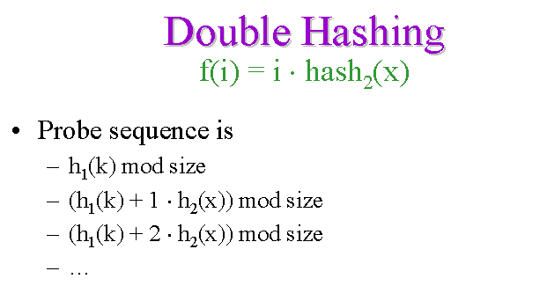

Slide 35
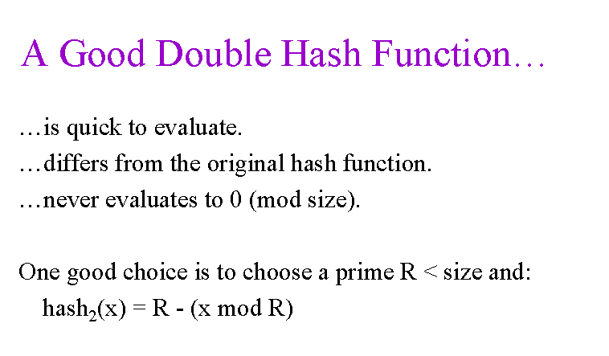

Slide 36
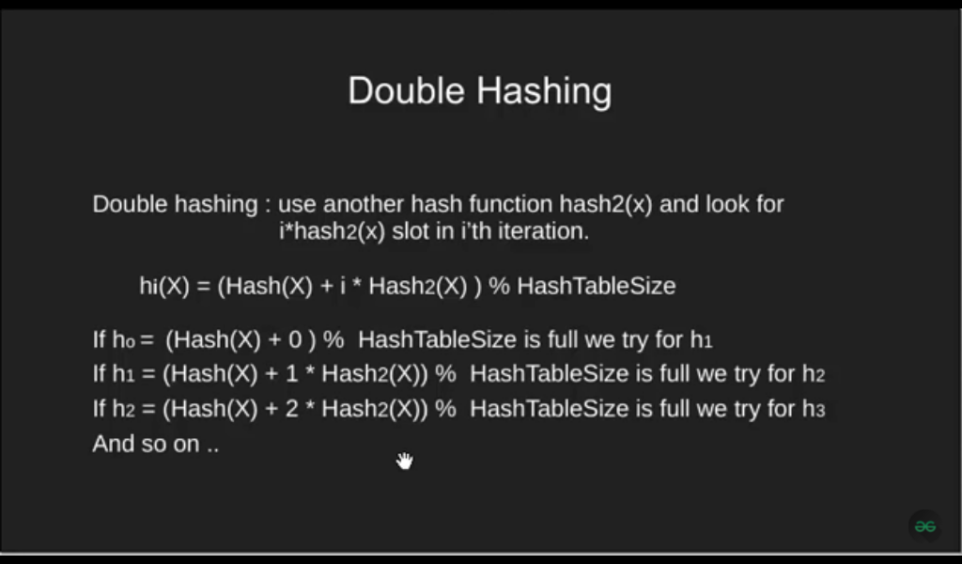

Slide 37
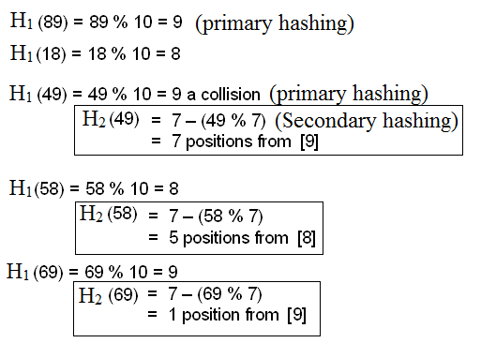
H1(k) = k%10
H2(k) = 7 - (k%7)

Slide 38
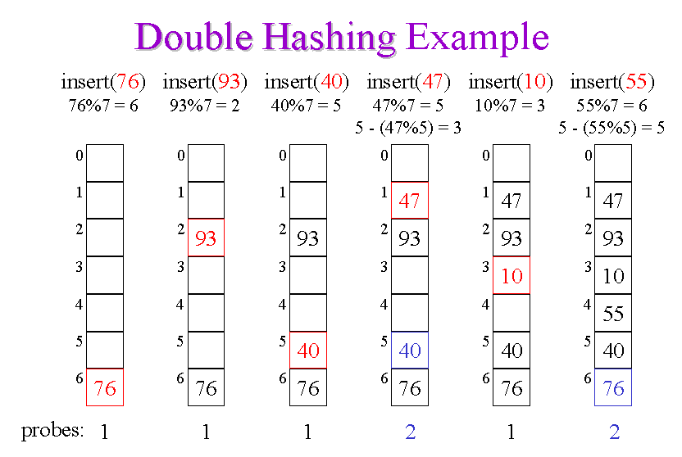
H1(k) = k%7
H2(k) = R - (k%R) //R can be the nearest prime less than 7

Slide 39
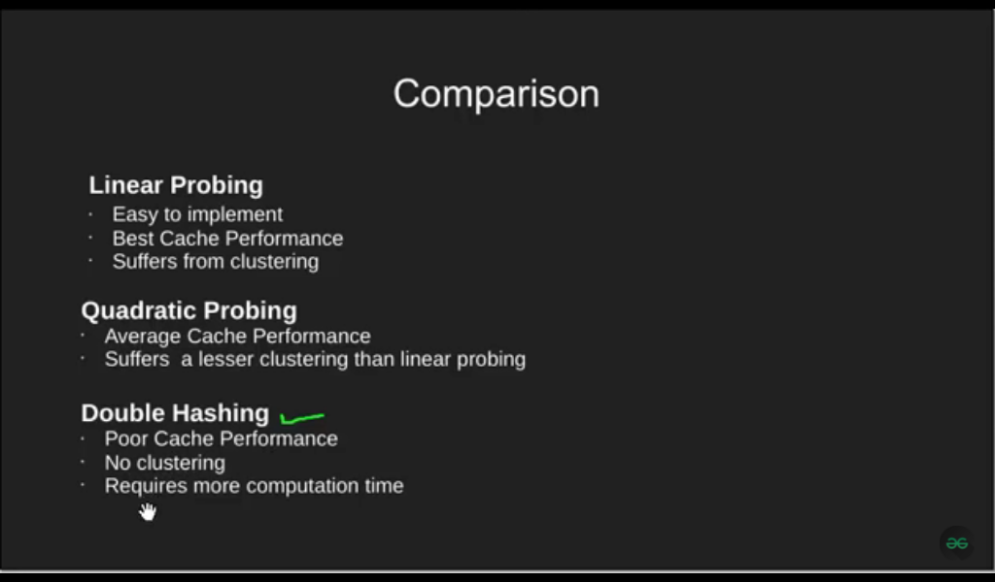

Slide 40
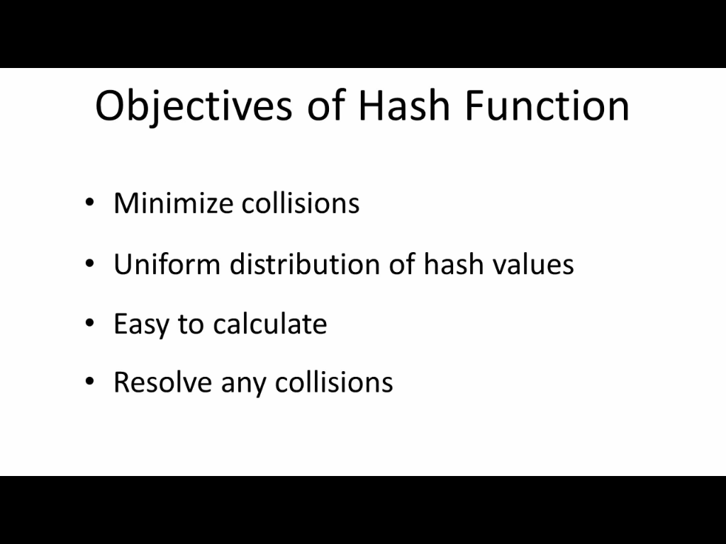

Slide 41
